Slide 1

A0597203 AI Business Applications
Introduction to Neural Networks

Slide 2
AI Business Applications
Introduction to Neural Networks

Slide 3
Outcomes
Fundamentals of neural networks
Evolution from single Perceptrons to MLPs
Detailed MLP architecture (input, hidden, and output layers)
Mathematical representations
Various activation functions (Sigmoid, ReLU, etc.)
Backpropagation and training methodologies
Loss functions and optimization techniques
Architecture design considerations
Real-world applications
Advantages and limitations
Modern MLP variants and implementations

Slide 4
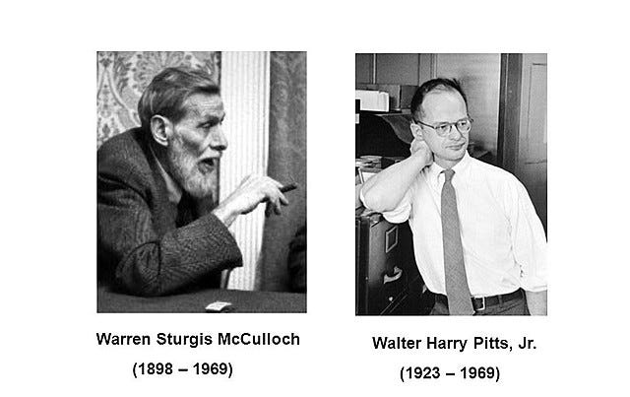
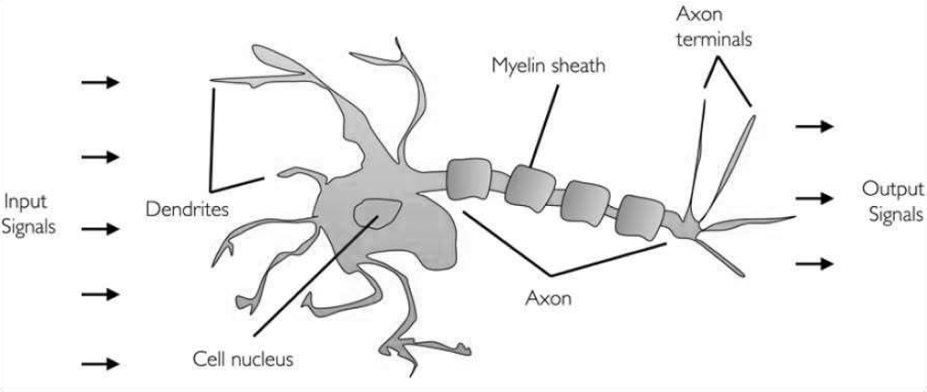
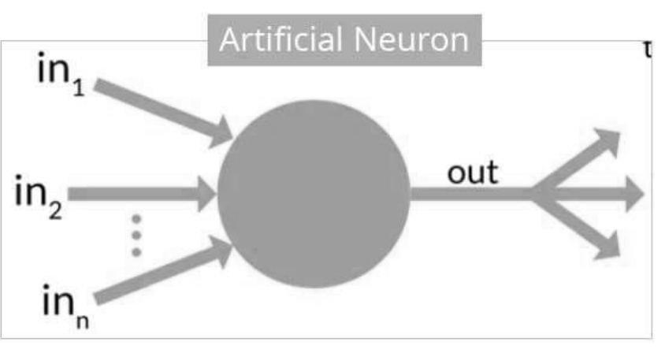
History of Neural Networks
In 1943, researchers Warren McCullock and published their first concept of simplified brain cell.
This was called McCullock-Pitts (MCP) neuron.
They described such a nerve cell as a simple logic gate with binary outputs.
Multiple signals arrive at the dendrites and are then integrated into the cell body, and, if the accumulated signal exceeds a certain threshold, an output signal is generated that will be passed on by the axon.

Slide 5
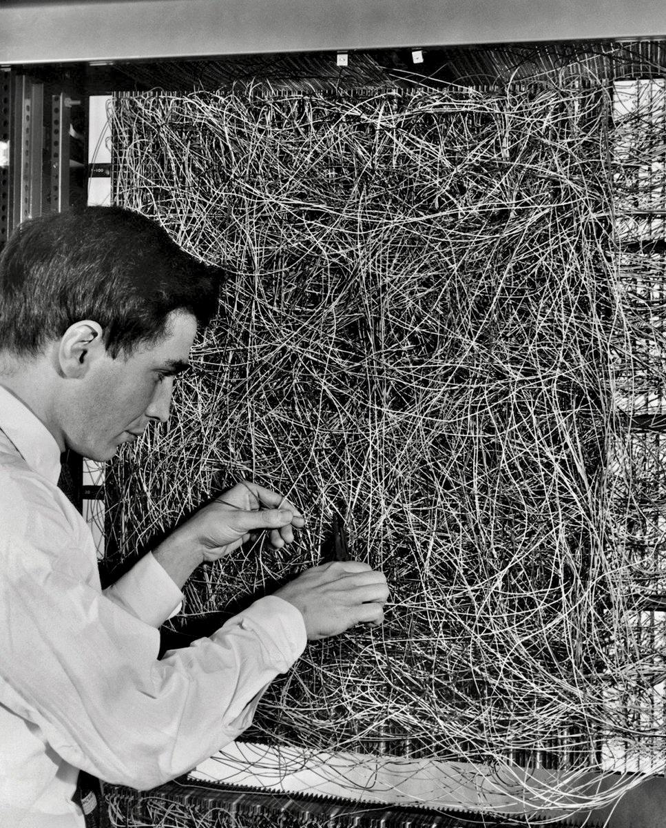
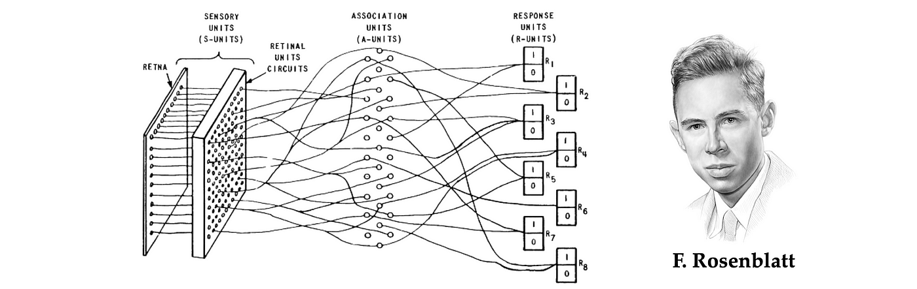
The Perceptron: Building Block of Neural Networks
In 1953, inspired by McCullock work, Frank Rosenblatt invented the Perceptron.
The Perceptron is the simplest form of a neural network
Binary classifier: separates data into two categories
Models a single neuron with multiple inputs and one output

Slide 6
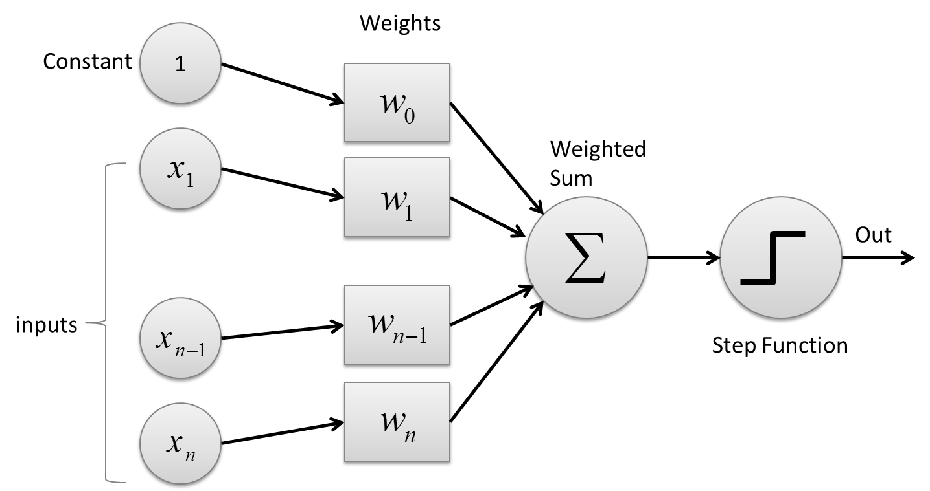
The Perceptron
Inputs: x₁, x₂, ..., xₙ
Weights: w₁, w₂, ..., wₙ
Bias: b
Activation function: Step function
Output: 1 if weighted sum > threshold, 0 otherwise

Slide 7
How a Perceptron Works
Multiply each input by its corresponding weight
Sum all weighted inputs
Add the bias term
Apply the activation function
Output the result
Mathematically:
z = w₁x₁ + w₂x₂ + ... + wₙxₙ + b
output = activation(z)

Slide 8
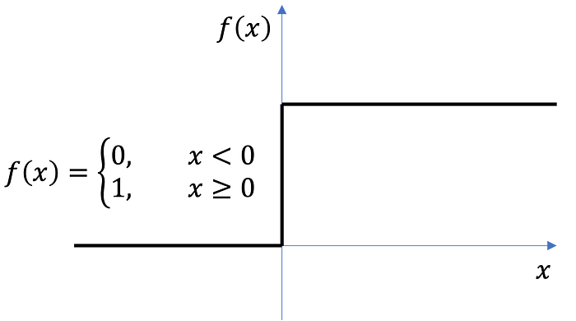
Perceptron Activation Function
Step Function:
Output: 1 if z ≥ 0, 0 if z < 0
Used in original perceptrons
Not differentiable at 0

Slide 9
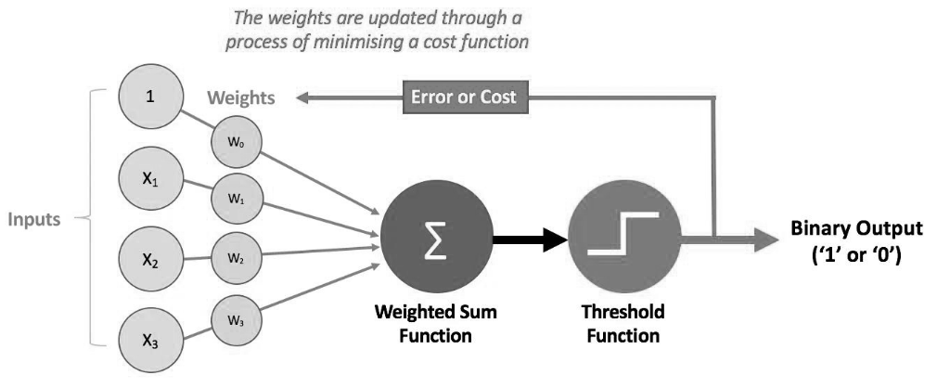
How Perceptron Learn (The Cost Function)
For each training example:
Calculate predicted output y_pred
Calculate error: error = y_true - y_pred
Update weights: w_new = w_old + learning_rate * error * x
Update bias: b_new = b_old + learning_rate * error

Slide 10
Step-by-Step Hand Calculation for AND Gate
Let's work through the perceptron learning algorithm by hand for the AND gate:
Training data: X = [[0,0], [0,1], [1,0], [1,1]], y = [0, 0, 0, 1]
Learning rate (η) = 0.1
Initial weights (randomly assigned): w₁ = 0.3, w₂ = -0.1
Initial bias: b = 0.2
First Iteration:
Example 1: (0,0) → 0
Inputs: x₁ = 0, x₂ = 0
Weighted sum: z = w₁x₁ + w₂x₂ + b = 0.3(0) + (-0.1)(0) + 0.2 = 0.2
Activation: output = 1 (since z > 0)
True output: y = 0
Error: error = y - output = 0 - 1 = -1
Weight updates:
w₁ = w₁ + η * error * x₁ = 0.3 + 0.1 * (-1) * 0 = 0.3
w₂ = w₂ + η * error * x₂ = -0.1 + 0.1 * (-1) * 0 = -0.1
b = b + η * error = 0.2 + 0.1 * (-1) = 0.1

Slide 11
Step-by-Step Hand Calculation for AND Gate
Example 2: (0,1) → 0
Inputs: x₁ = 0, x₂ = 1
Weighted sum: z = w₁x₁ + w₂x₂ + b = 0.3(0) + (-0.1)(1) + 0.1 = 0
Activation: output = 1 (since z ≥ 0)
True output: y = 0
Error: error = y - output = 0 - 1 = -1
Weight updates:
w₁ = w₁ + η * error * x₁ = 0.3 + 0.1 * (-1) * 0 = 0.3
w₂ = w₂ + η * error * x₂ = -0.1 + 0.1 * (-1) * 1 = -0.2
b = b + η * error = 0.1 + 0.1 * (-1) = 0
Example 3: (1,0) → 0
Inputs: x₁ = 1, x₂ = 0
Weighted sum: z = w₁x₁ + w₂x₂ + b = 0.3(1) + (-0.2)(0) + 0 = 0.3
Activation: output = 1 (since z > 0)
True output: y = 0
Error: error = y - output = 0 - 1 = -1
Weight updates:
w₁ = w₁ + η * error * x₁ = 0.3 + 0.1 * (-1) * 1 = 0.2
w₂ = w₂ + η * error * x₂ = -0.2 + 0.1 * (-1) * 0 = -0.2
b = b + η * error = 0 + 0.1 * (-1) = -0.1

Slide 12
Step-by-Step Hand Calculation for AND Gate
Example 4: (1,1) → 1
Inputs: x₁ = 1, x₂ = 1
Weighted sum: z = w₁x₁ + w₂x₂ + b = 0.2(1) + (-0.2)(1) + (-0.1) = -0.1
Activation: output = 0 (since z < 0)
True output: y = 1
Error: error = y - output = 1 - 0 = 1
Weight updates:
w₁ = w₁ + η * error * x₁ = 0.2 + 0.1 * 1 * 1 = 0.3
w₂ = w₂ + η * error * x₂ = -0.2 + 0.1 * 1 * 1 = -0.1
b = b + η * error = -0.1 + 0.1 * 1 = 0
End of Iteration 1:
Updated weights: w₁ = 0.3, w₂ = -0.1
Updated bias: b = 0

Slide 13
Second Iteration
Example 1: (0,0) → 0
Inputs: x₁ = 0, x₂ = 0
Weighted sum: z = w₁x₁ + w₂x₂ + b = 0.3(0) + (-0.1)(0) + 0 = 0
Activation: output = 1 (since z ≥ 0)
True output: y = 0
Error: error = y - output = 0 - 1 = -1
Weight updates:
w₁ = w₁ + η * error * x₁ = 0.3 + 0.1 * (-1) * 0 = 0.3
w₂ = w₂ + η * error * x₂ = -0.1 + 0.1 * (-1) * 0 = -0.1
b = b + η * error = 0 + 0.1 * (-1) = -0.1
Example 2: (0,1) → 0
Inputs: x₁ = 0, x₂ = 1
Weighted sum: z = w₁x₁ + w₂x₂ + b = 0.3(0) + (-0.1)(1) + (-0.1) = -0.2
Activation: output = 0 (since z < 0)
True output: y = 0
Error: error = y - output = 0 - 0 = 0
Weight updates (no change as error = 0):
w₁ = 0.3
w₂ = -0.1
b = -0.1
After several iterations, the perceptron will converge to weights that correctly classify all AND gate examples.

Slide 14

Python Implementation Perceptron from Scratch
from sklearn.linear_model import Perceptron
import numpy as np
# Training data for AND gate
X = np.array([[0, 0], [0, 1], [1, 0], [1, 1]])
y = np.array([0, 0, 0, 1])
# Initialize and train Perceptron
model = Perceptron(max_iter=100, eta0=0.1, random_state=42)
model.fit(X, y)
# Results
print("Weights:", model.coef_)
print("Bias:", model.intercept_)
print("Predictions:", model.predict(X))
The code shows a scikit-learn Perceptron implementation for the AND gate problem.
The code:
Imports NumPy, scikit-learn's Perceptron, and matplotlib
Sets up the training data for the AND gate
Initializes a Perceptron with 100 max iterations and a random seed of 42
Trains the perceptron on the AND gate data
Prints the learned weights, bias, and predictions
The output shows:
Weights: [[0.2 0.2]] - The perceptron learned to assign a weight of 0.2 to both inputs
Bias: [-0.2] - The bias is -0.2
Predictions: [0 0 0 1] - The perceptron correctly classified all four examples of the AND gate
With these weights and bias, the decision function is: 0.2×(input1) + 0.2×(input2) – 0.2
For the four input combinations:
[0,0]: 0.2×0 + 0.2×0 - 0.2 = -0.2 < 0 → output 0
[0,1]: 0.2×0 + 0.2×1 – 0.2 = 0 → output 0
[1,0]: 0.2×1 + 0.2×0 – 0.2 = 0 → output 0
[1,1]: 0.2×1 + 0.2×1 – 0.2 = 0.2 > 0 → output 1
This perceptron implements the AND gate logic.
The decision boundary is the line 2x₁ + 2x₂ - 0.2 = 0, which separates the point (1,1) from the other three points.

Slide 15
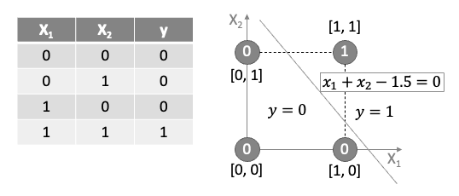
Decision Boundary
The perceptron learns a decision boundary: w₁x₁ + w₂x₂ + b = 0
Points above the line are classified as 1
Points below the line are classified as 0
For AND gate, only the point (1,1) should be above the line

Slide 16
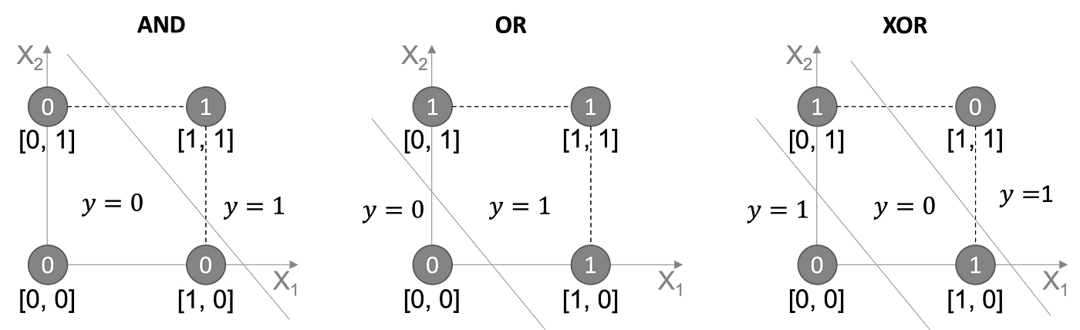
Limitations of Simple Perceptron
Can only learn linearly separable patterns
Cannot solve XOR problem (need multiple layers)
No probabilistic output
Simple update rule isn't suitable for complex problems

Slide 17
Introduction to Neural Networks
Multi-Layer Neural Networks

Slide 18

The Multi-Layer Percecptron (MLP)
Limitations of the Perceptron
While useful for linearly separable problems, the single perceptron cannot solve complex problems like XOR classification, as demonstrated by Minsky and Papert in their 1969 book "Perceptrons.“
The Multi-Layer Perceptron
The Multi-Layer Perceptron addresses the limitations of the single perceptron by introducing:
Multiple layers of neurons
Non-linear activation functions
More sophisticated learning algorithms

Slide 19
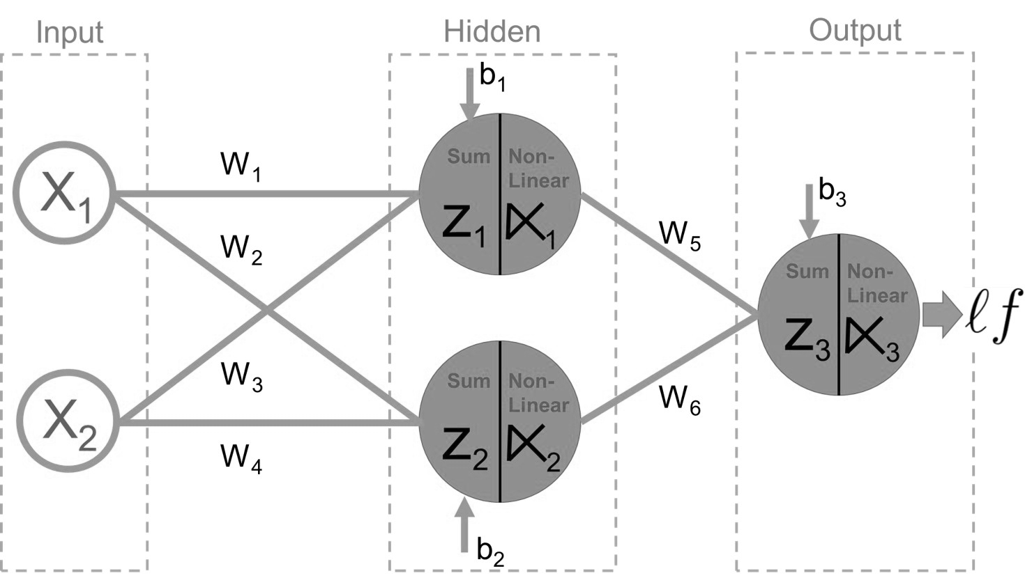
Structure of an MLP
Definition: An MLP is a class of feedforward artificial neural network that consists of at least three layers of nodes: input, hidden, and output layers.
Key Feature: Each neuron in one layer is connected to every neuron in the next layer (fully connected).
1. Input Layer
Receives the raw input features
One neuron per input feature
No computation occurs here; inputs are simply passed forward
2. Hidden Layer(s)
One or more layers between input and output
Each neuron in a hidden layer:
Receives inputs from all neurons in the previous layer
Computes a weighted sum
Applies a non-linear activation function
Passes the result to the next layer
3. Output Layer
Produces the final prediction or classification
Structure depends on the task:
Regression: Often a single neuron with linear activation
Binary classification: One neuron with sigmoid activation
Multi-class classification: Multiple neurons (one per class) with softmax activation

Slide 20
Structure of an MLP
3. Neurons and Connections
Each neuron computes a weighted sum of inputs and applies an activation function
Fully connected between layers (dense connections)
4. Activation Functions
Introduce non-linearity
Examples: ReLU, Sigmoid, Tanh, Softmax
5. Loss Function
Measures the error between predicted and true outputs
Examples: Mean Squared Error, Cross-Entropy
6. Optimizer
Updates weights to minimize loss
Examples: SGD, Adam
7. Training Data
Labeled data used to train the network
Split into training, validation, and test sets

Slide 21
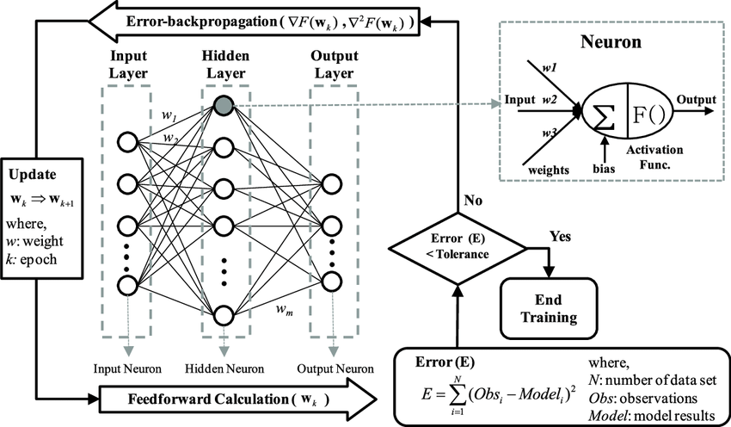
How an MLP Learn – Step by Step
Forward Propagation
Input features pass through the network layer by layer.
Each neuron computes a weighted sum of inputs and applies an activation function.
The final layer produces a prediction.
Loss Computation
A loss function measures the difference between predicted and actual outputs.
Common loss functions:
Mean Squared Error (regression)
Cross-Entropy Loss (classification)

Slide 22
How an MLP Learn – Training Process
Backpropagation
Gradients of the loss are calculated with respect to each weight using the chain rule.
This identifies how each weight contributed to the error.
Weight Update
An optimizer (e.g., SGD) adjusts weights to reduce loss:
w := w - learning_rate × gradient
This process repeats over multiple iterations (epochs) using training data.
Goal
Gradually minimize the loss and improve prediction accuracy.
Loss Function: MSE for regression, Cross-Entropy for classification.
Optimization: Backpropagation + Gradient Descent (or Adam).

Slide 23
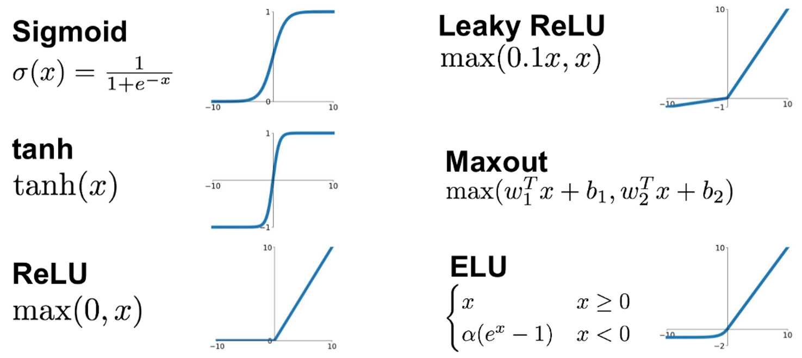
Activation Functions other than Step Function
Neural Networks use activation functions other than the simple step function in the Perceptron.
Activation Function helps the neural network use important information while suppressing irrelevant data points (i.e., allows local “gating” of information).
Common Activation Functions: A Toolbox for Neural Networks
Sigmoid: Compresses input to a range between 0 and 1.
Tanh: Like sigmoid but ranges from -1 to 1.
ReLU: Passes positive values, zeroes out negatives.
Leaky ReLU: Allows a small, non-zero gradient for negative inputs.
Maxout: Chooses the most active linear response.
ELU: Smoothly transitions through zero and allows negative outputs.
Each function offers a trade-off between simplicity, flexibility, and computational cost—choose based on the task and depth of your model
https://ml-explained.com/blog/activation-functions-explained

Slide 24
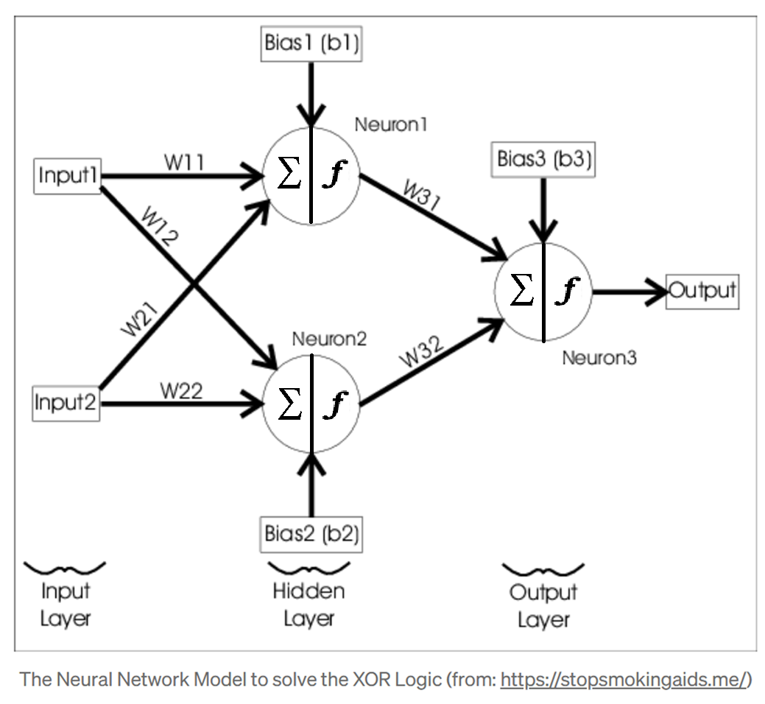
Representing Weights as Matrices
Matrix Representations for Weights
Weight Matrices:
W⁽¹⁾: Weights from Input to Hidden Layer
(shape: input_size × hidden_size):
[ w₁,₁⁽¹⁾ w₁,₂⁽¹⁾ ]
[ w₂,₁⁽¹⁾ w₂,₂⁽¹⁾]
Hidden Layer Bias (b₁):
[ b₁₁ b₁₂ ]
W⁽²⁾: Weights from Hidden to Output Layer
(shape: hidden_size × output_size):
[ w₁,₁⁽²⁾ ]
[ w₂,₁⁽²⁾ ]
Output Layer Bias (b₂):
[ b₂₁ ]
Forward Pass Matrix Operations:
Input to hidden layer: Z₁ = X · W₁ + b₁
Hidden to output layer: Z₂ = A₁ · W₂ + b₂
Backpropagation Matrix Operations:
Weight updates use matrix multiplication between layer activations and error gradients
W₂ update: W₂ += A₁ᵀ · delta₂ × learning_rate
W₁ update: W₁ += Xᵀ · delta₁ × learning_rate

Slide 25
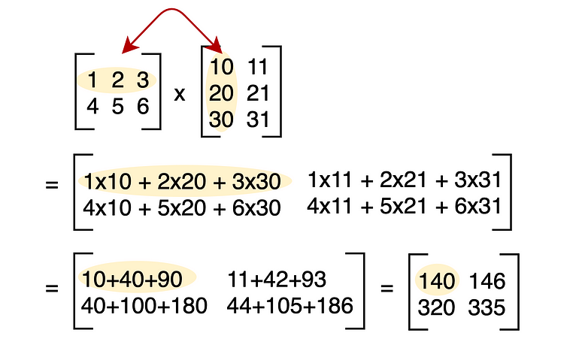
Matrix Multiplication

Slide 26
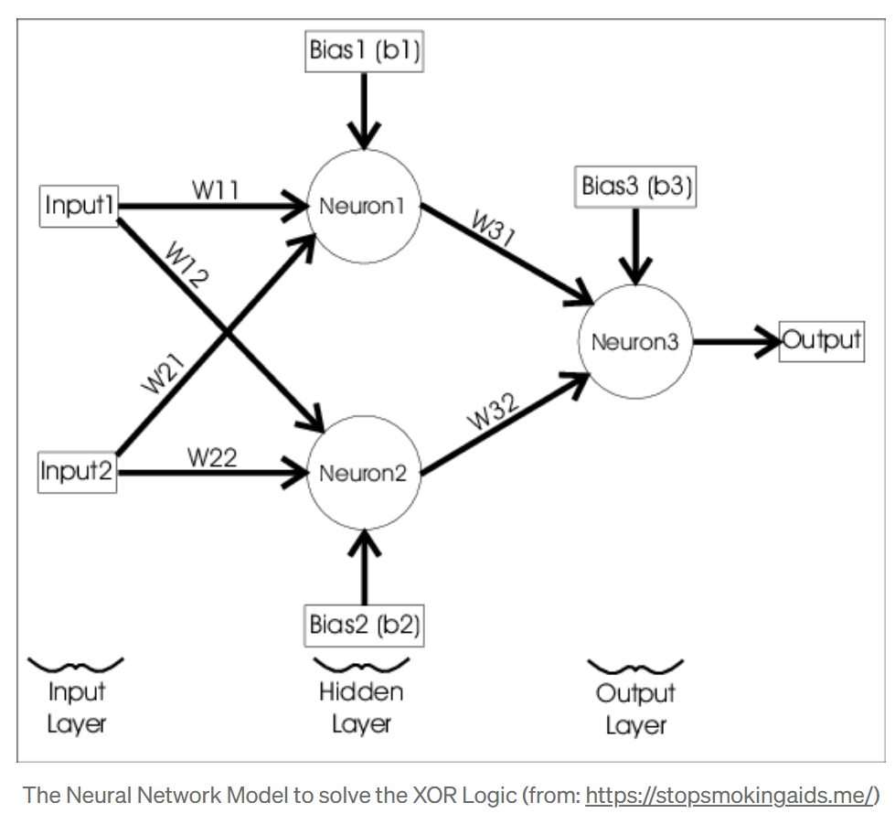
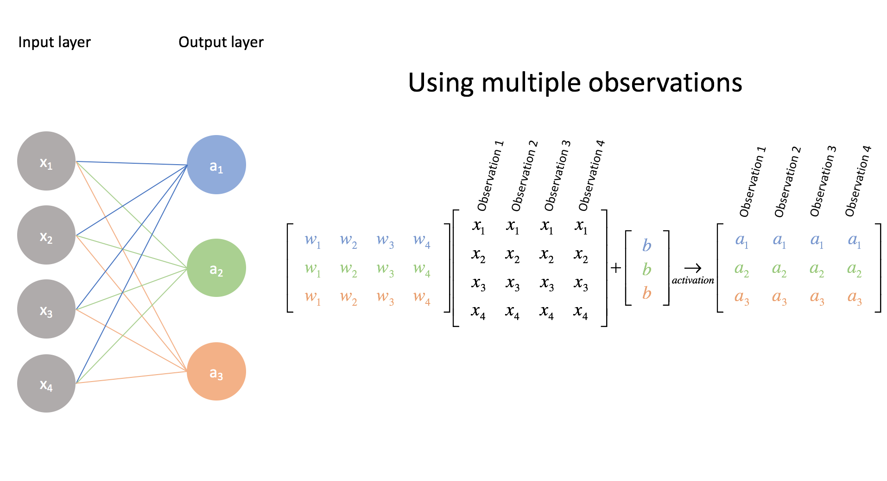
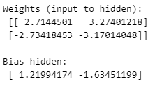
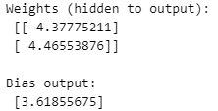
Multi-Layer Perceptron in Python
from sklearn.neural_network import MLPClassifier
import numpy as np
# XOR input and output
X = np.array([[0, 0], [0, 1], [1, 0], [1, 1]])
y = np.array([0, 1, 1, 0])
# Define MLP with 1 hidden layer of 2 neurons (minimal config for XOR)
mlp = MLPClassifier(hidden_layer_sizes=(2,), activation='tanh’, solver='adam', learning_rate_init=0.01, max_iter=10000, random_state=42)
# Train the model
mlp.fit(X, y)
# Make predictions
predictions = mlp.predict(X)
print("Predictions:\n", predictions)
print("\nWeights (input to hidden):\n", mlp.coefs_[0])
print("\nBias hidden:\n", mlp.intercepts_[0])
print("\nWeights (hidden to output):\n", mlp.coefs_[1])
print("\nBias output:\n", mlp.intercepts_[1])

Slide 27

Simple Neural Network in Python
import numpy as np
# Simple feedforward neural network
def neural_network(x, weights):
# First hidden layer with ReLU activation
hidden = np.maximum(0, np.dot(x, weights[0]) + weights[1]) # ReLU activation # Output layer
output = np.dot(hidden, weights[2]) + weights[3] return output
# Example network with random weights
input_size = 3
hidden_size = 4
output_size = 2
# Initialize random weights
W1 = np.random.randn(input_size, hidden_size) # Input → Hidden
b1 = np.random.randn(hidden_size) # Hidden bias
W2 = np.random.randn(hidden_size, output_size) # Hidden → Output
b2 = np.random.randn(output_size) # Output bias
weights = [W1, b1, W2, b2]
# Example input
x = np.array([0.5, 0.3, 0.2])
# Forward pass
prediction = neural_network(x, weights)
print(f"Network prediction: {prediction}")

Slide 28
Backpropagation (Conceptual)
import numpy as np
# Simplified backpropagation example
def train_step(x, y_true, weights, learning_rate=0.01):
# Forward pass
hidden = np.maximum(0, np.dot(x, weights[0]) + weights[1]) # ReLU
y_pred = np.dot(hidden, weights[2]) + weights[3]
# Compute loss (Mean Squared Error)
loss = np.mean((y_pred - y_true)**2)
# Backpropagation (simplified)
# Output layer gradients
grad_y_pred = 2 * (y_pred - y_true) / len(y_true)
grad_W2 = np.dot(hidden.T, grad_y_pred)
grad_b2 = np.sum(grad_y_pred, axis=0)
# Hidden layer gradients
grad_hidden = np.dot(grad_y_pred, weights[2].T)
grad_hidden[hidden <= 0] = 0 # ReLU gradient
grad_W1 = np.dot(x.T, grad_hidden)
grad_b1 = np.sum(grad_hidden, axis=0)
# Update weights
weights[0] -= learning_rate * grad_W1
weights[1] -= learning_rate * grad_b1
weights[2] -= learning_rate * grad_W2
weights[3] -= learning_rate * grad_b2
return loss, weights
# Example usage
# (In practice, we would use frameworks like PyTorch or TensorFlow)

Slide 29
The Difference Between a Perceptron and an MLP?
Feature | Perceptron | Multilayer Perceptron (MLP)
Layers | Only 1 layer (no hidden layers) | 2+ layers (has hidden layers)
Activation Function | Step function (hard threshold) | Nonlinear (e.g., ReLU, sigmoid, tanh)
Learning Rule | Simple rule: update on error | Gradient descent + backpropagation
Tasks It Can Solve | Only linearly separable problems | Nonlinear, complex problems

